Slide 1
Disorders of Skin Color

Slide 2
Vitiligo
Definition:
It’s an acquired loss of pigment of the skin.
It usually begins in childhood. Usually < 30.
It affects both sexes.
It occurs in all races.

Slide 3
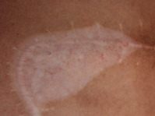
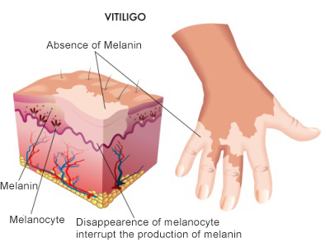
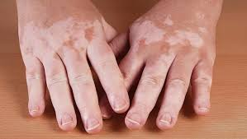

Slide 4
Aetiology:
unknown. Multi-factorial disorder
1- Inheritance.
2- Autoimmune destruction of melanocytes.
3- Neurogenic theory

Slide 5
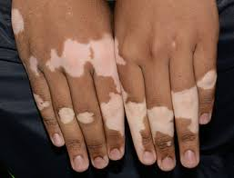
Clinical picture
Well defined depigmented (milky white) patches surrounded by a normal or a hyperpigmented border. The hair in vitiliginous areas usually become white

Slide 6
Site:
- Any site can be involved.
- Vitiligo may involve the entire body surface.

Slide 7
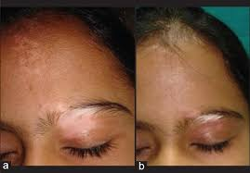
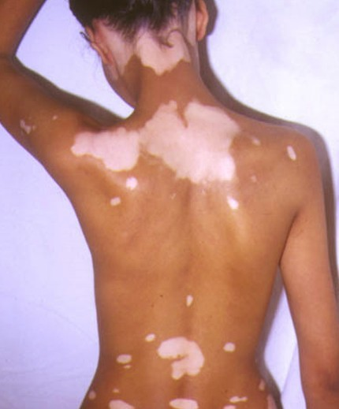
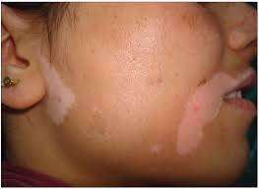

Slide 8
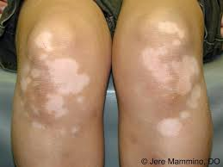
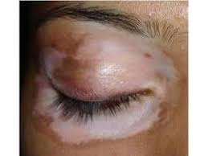
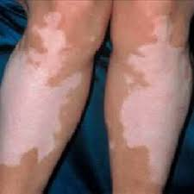

Slide 9
Treatment
Is generally unsatisfactory.
1- Cosmetic camouflage for lesions on the exposed skin.
2- Topical corticosteroids or calcineurin inhibitors.
3- Phototherapy.
4- Surgical treatment e.g. minigrafts

Slide 10
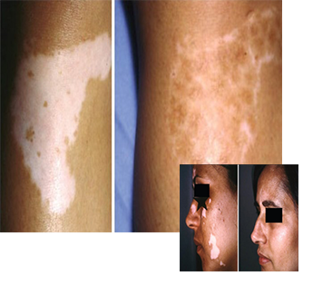
Surgical ttt of vitiligo

Slide 11
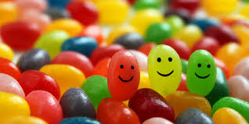
Thank You

